Slide 1
Introduction to Oracle Forms Developer and Oracle Forms Services
Notes:
Schedule: Timing Topic
45 minutes Lecture
25 minutes Practice
70 minutes Total

Slide 2
Objectives
After completing this lesson, you should be able to do the following:
  Describe the components of Oracle9i Developer Suite and the Oracle9i Application Server
  Describe the features and benefits of Oracle Forms Services and Oracle Forms Developer
  Describe the architecture of Oracle Forms Services
  Describe Forms Builder components
  Navigate the Forms Builder interface
  Customize the Forms Builder session
  Use the online help facilities
  Describe the course application
Notes:
Introduction
Overview
This course teaches you how to build effective and professional form applications using Oracle Forms Developer.
This lesson identifies the key features of Oracle Forms Developer, Oracle Forms Services, and the course application model and contents.
There are many terms used in this course that may be unfamiliar to you. For a glossary containing definitions of many of these terms, see http://www.oracle.com/glossary.

Slide 3
Internet Computing Solutions
Oracle offers a range of tools and deployment options for Internet computing. Different types of developers and applications require different toolsets
Application Type
and Audience
Product
Approach
Oracle
Products
Enterprise applications,
Business developers
Repository-based
modeling & generation,
Declarative
Oracle Designer,
Oracle Forms Developer,
& Oracle Forms Services
Java components,
Component developers
Two-way coding,
Java and JavaBeans
Oracle JDeveloper
Oracle9i Application Server
Self-service applications &
content management,
Web site developers
Browser-based,
Dynamic HTML
Oracle Portal
Oracle Database Server
Reporting and
analytical applications,
MIS & business users
Dynamic Web
reporting, Drill,
Analyzing, Forecasting
Oracle Reports Developer,
Oracle Reports Services,
Oracle Discoverer, &
Oracle Express
Notes:
Internet Computing Solutions
Oracle offers a range of tools and deployment options for Internet computing. Different types of developers and applications require different toolsets.
Enterprise application developers need a declarative model-based approach. Oracle Designer and Oracle Forms Developer provide this solution. This course focuses on how you can use Oracle Forms Developer to rapidly build scalable, high-performance applications for the Internet and then deploy the applications with Oracle Forms Services.
Component developers need different tools and methods. For these developers, Java is the language of choice. Oracle’s solution is JDeveloper.
For Web site developers and content publishers who want to build self-service dynamic Hypertext Markup Language (HTML) applications for Web sites, Oracle Portal provides an easy-to-use development environment that resides entirely inside an Oracle9i database. Portal provides a browser-based environment from development through deployment of an application.
For Management Information System (MIS) developers and end users, there is the Oracle Business Intelligence toolset. Oracle Reports Developer, Oracle Reports Services, Oracle Discoverer, and Oracle Express provide the whole range for reporting, analysis, and trending facilities.

Slide 4




Oracle9i Products
Forms Services
Forms Developer
Notes:
Oracle9i Products
Oracle9i Database: Manages all of your information, such as Word documents, Excel spreadsheets, XML, and images. Oracle9iDS tools can automatically reuse the database structure and its integrity constraints, which reduces the amount of manual coding.
Oracle9i Application Server (Oracle9iAS): Runs all of your applications, including Java, wireless, portals, and business intelligence. Using Oracle9iAS, you can deploy and manage in a single application server all applications developed with Oracle9iDS. The Oracle9i Application Server contains Oracle9i Forms Services that you use to deploy your Forms applications.
Oracle9i Developer Suite (Oracle9iDS): Leverages the infrastructure offered by Oracle9i Application Server (Oracle9iAS) and Oracle9i Database, enabling developers to quickly and easily build scalable, secure, and reliable e-business applications. The suite provides a complete and highly productive development environment for building applications. Oracle9i Forms Developer that you use to build Forms applications is part of Oracle9i Developer Suite.

Slide 5
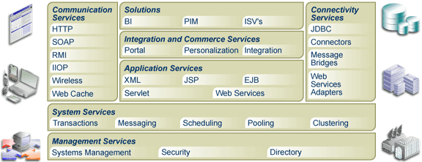
Oracle 9iAS Architecture
Notes:
Oracle9i Application Server Architecture
Oracle9iAS has a layered architecture that consists of the following services:
Communication Services - Communication management for a variety of protocols
Application Runtime Services - A J2EE Container that provides a common runtime environment for Applications developed as JSPs, Servlets,EJBs, and Web Services
System Services - A common set of runtime services that are necessary for J2EE Applications and Web Services, such as request dispatch and scheduling, resource management, resource pooling,clustering, fault monitoring, transaction management, and messaging
Management Services - A common set of systems management services to monitor the status, performance and faults of the system; to monitor resource consumption and usage; to manage a single instance or cluster of instances; to centrally administer security for users and applications; and to provide a comprehensive directory service framework to manage users
Connectivity Services - Provide connectivity to a variety of systems
Solutions - A comprehensive set of solutions all built on the infrastructure described above including Enterprise Portals, Enterprise Integration, Business Intelligence, Wireless, and ISV Solutions

Slide 6
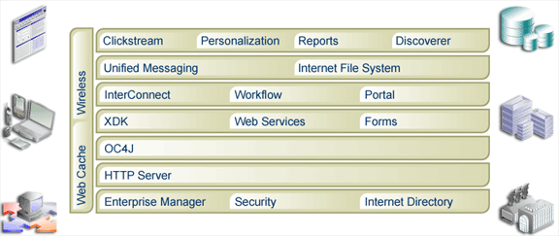

Oracle 9iAS Components
Oracle9iAS Forms Services
Notes:
Oracle9i Application Server Components
With the components of Oracle 9iAS, you can:
Extract and analyze business intelligence: Clickstream, Personalization, Reports Services, Discoverer
Integrate your business: InterConnect, Workflow, Unified Messaging, Internet File System
Create personalized portals: Oracle 9iAS Portal
Deploy dynamic Web applications: XDK, Web Services, Forms Services, OC4J, HTTP Server
Manage and secure your Web infrastructure: Enterprise Manager, Security, Internet Directory.
Instructor Note
The overviews of iAS and iDS should not be presented in detail, but merely to show where Forms Services and Forms Developer fit into the product set. For further information on Oracle9iAS architecture and components, see:
Oracle9i Application Server Product White Paper, January 2002.
Oracle9i Application Server Release 2 Data Sheet, December 2001.

Slide 7





Oracle Forms Services Overview
A component of Oracle9i Application Server that deploys Forms applications to Java clients in a Web environment.
Oracle9iAS Forms Services
Notes:
What Is Oracle Forms Services?
Oracle Forms Services is a component of Oracle9i Application Server for delivering Oracle Forms Developer applications to the Internet. Oracle Forms Services automatically provides the infrastructure that is needed to successfully deliver applications on the Internet through built-in services and optimizations.
Oracle Forms Services uses a three-tier architecture to deploy database applications:
The client tier contains the Web browser, where the application is displayed and used.
The middle tier is the application server, where the application logic and server software reside.
The database tier is the database server, where enterprise data is stored.

Slide 8




Forms Services Architecture
Middle Tier:
Application Server
Client Tier
Database Tier
Forms Listener
Servlet
Forms Servlet
Incrementally
downloaded
Forms Runtime
User interface
layer
Net
Services
DB
Application
logic layer
Data manager/
PL/SQL engine
JRE
Java applet
File containing
application code
Notes:
Forms Services Architecture
Forms Services consists of four major components: the Java client (Forms Client), the Forms Listener Servlet, the Forms Servlet, and the Forms Runtime Engine. You learn about these components in Lesson 2, Running a Forms Developer Application.
When a user runs a forms session over the Web, a thin, Java-based Forms applet is dynamically downloaded from the application server and automatically cached on the Java client machine. The same Java applet code can be used for any form, regardless of size and complexity.
Although Forms Services uses a Java applet for displaying the form on the client browser, the developer does not need to know Java in order to develop and deploy a Forms application.
Instructor Note
See Oracle9iAS Forms Services: Technical Overview for additional information on Forms Services.

Slide 9

Benefits of Oracle9i Developer Suite
Application Development
OWB
Discoverer
Reports
JDeveloper
Forms
Designer
SCM
Business Intelligence
Notes:
Benefits of Oracle9i Developer Suite
The Oracle9i Developer Suite:
Combines the power of Oracle Application Development tools and Oracle Business Intelligence tools.
Provides a standards-based, Java and XML Integrated Development Environment and supports the full application development life-cycle.
Provides flexible and scalable solutions for Data Warehousing and Business Intelligence.
Optimized for the Oracle9i Database and Oracle9i Application Server
Instructor Note
For further information on Oracle9iDS features and components, see:
Oracle9i Developer Suite Product White Paper, December 2001.

Slide 10
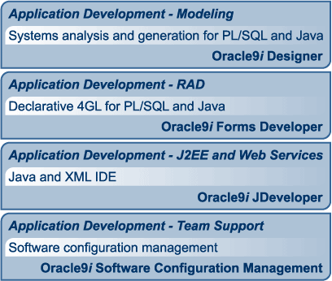
Oracle9iDS Application Development
Notes:
Application Development Features of Oracle9i Developer Suite
Oracle9iDS provides the following features for application development:
Modeling
Oracle9i Designer provides visual modeling, reverse engineering, and code generation tools. Oracle9iDS also supports UML (Unified Modeling Language) by utilizing visual tools for Activity and Class modeling within the JDeveloper component.
Rapid Application Development (RAD)
RAD capabilities in Oracle9iDS feature integrated builders, re-entrant wizards, live previewers, and property inspectors. The JDeveloper component provides additional productivity through Business Components for Java (BC4J), a built-in J2EE framework.
J2EE and Web Services
Oracle9iDS supports the latest J2EE 1.2 APIs, including Enterprise JavaBeans (EJB), Java Server Pages (JSP), and Servlets. Web services support SOAP (Simple Object Access Protocol), WSDL (Web Service Definition Language), and UDDI (Universal Description, Discovery, and Integration).
Team Support
Oracle9i Software Configuration Management provides versioning, dependency management, and impact analysis for all objects and file types.

Slide 11
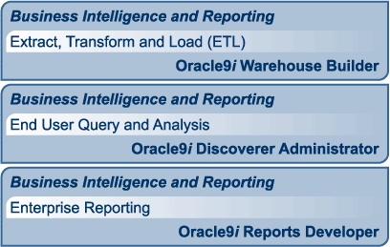
Oracle9iDS Business Intelligence
Notes:
Business Intelligence Features of Oracle9i Developer Suite
Oracle9iDS provides the following Business Intelligence features:
Extract, transformation, and load (ETL)
Oracle9i Warehouse Builder provides a graphical interface for mapping and transformation. It also provides an extensible framework for integrating a diverse set of data sources and integration with Business Intelligence Tools.
End user query and analysis
With Oracle9i Discoverer Administrator, you can create and maintain a business-oriented view of the data that supports the Discoverer client tools: Discoverer Plus and Discoverer Viewer (in Oracle9iAS), and Discoverer Desktop (in Oracle9iDS).
Enterprise Reporting
Oracle9i Reports Developer enables the developer to access any data, to publish it in any format, and to send it anywhere. Supported formats include HTML with CSS, PDF, RTF, Postscript, and XML.

Slide 12
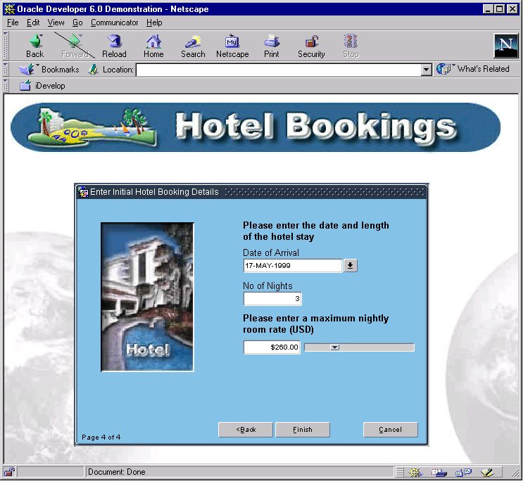

Oracle Forms Developer Overview
Oracle Forms Developer:
  Is a productive development
  environment for Internet
  business applications
  Provides for:
    Data entry
    Queries
Notes:
What Is Oracle Forms Developer?
Oracle Forms Developer, a component of the Oracle Internet Developer Suite, is a productive development environment for building enterprise-class, scalable database applications for the Internet. Oracle Forms Developer provides a set of tools that enable business developers to easily and quickly construct sophisticated database forms and business logic with a minimum of effort.
Oracle Forms Developer uses powerful declarative capabilities to rapidly create applications from database definitions that leverage the tight integration with Oracle9i. The toolset leverages Java technology, promotes reuse, and is designed to allow developers to declaratively build rich user interfaces.
Developer productivity is further increased through a single integrated development environment that enables distributed debugging across all tiers, utilizing the same PL/SQL language for both server and client.
Oracle Forms Developer’s tight integration with Oracle Designer enables you to use a productive model-driven development approach. Oracle Forms Developer applications can be automatically generated from business requirements designed in the Oracle Designer modeling environment. These models are stored in the Oracle Repository. Code-level changes made within the Oracle Forms Developer environment can be automatically reverse engineered back into the models, preserving the integrity between the models and the application.

Slide 13
Oracle9i Forms Developer: Key Features
  Tools for rapid application development
    You can create and modify applications with little or no code
  Application partitioning
    You can place individual PL/SQL program units on the database server or in the application
  Flexible source control
    Oracle9i Software Configuration Manager (SCM) is integrated directly in Forms Developer to provide source control options
  Extended scalability
    The multi-tiered architecture enables you to scale applications from a single user to tens of thousands of users, with no changes to the application
Notes:
Oracle9i Forms Developer: Key Features
Tools for Rapid Application Development: You can create and modify applications with little or no code. Productivity is enhanced with wizard-based rapid application development and built-in commands that perform common functions.
Application Partitioning: You can place individual PL/SQL program units on the database server or in the application, whichever is most suitable. You can drag-and-drop objects between modules and the database server.
Flexible Source Control: Oracle9i Software Configuration Manager (SCM) is integrated directly in Forms Developer to provide source control options, such as checkin and checkout capability, versioning, diff and merge utilities, and impact analysis.
Extended Scalability: The multi-tiered architecture enables you to scale applications from a single user to tens of thousands of users, with no changes to the application. You can use server functionality, such as array DML, database cursors, or bind variables, to improve scalability.
Object Reuse: Oracle Forms Developer offers an inheritance model that facilitates the inheritance of attributes and code from one object to another and from one application to another, through subclassing and object libraries.

Slide 14
Oracle9i Forms Developer: Key Features
  Object reuse
    Oracle Forms Developer offers an inheritance model that facilitates the inheritance of attributes and code from one object to another and from one application to another, through subclassing and object libraries
Notes:
Oracle9i Forms Developer: Key Features
Tools for Rapid Application Development: You can create and modify applications with little or no code. Productivity is enhanced with wizard-based rapid application development and built-in commands that perform common functions.
Application Partitioning: You can place individual PL/SQL program units on the database server or in the application, whichever is most suitable. You can drag-and-drop objects between modules and the database server.
Flexible Source Control: Oracle9i Software Configuration Manager (SCM) is integrated directly in Forms Developer to provide source control options, such as checkin and checkout capability, versioning, diff and merge utilities, and impact analysis.
Extended Scalability: The multi-tiered architecture enables you to scale applications from a single user to tens of thousands of users, with no changes to the application. You can use server functionality, such as array DML, database cursors, or bind variables, to improve scalability.
Object Reuse: Oracle Forms Developer offers an inheritance model that facilitates the inheritance of attributes and code from one object to another and from one application to another, through subclassing and object libraries.

Slide 15
Forms Builder Components:
  Object Navigator
  Property Palette
  Layout Editor
  PL/SQL Editor
Notes:
Forms Builder Components: Object Navigator
The interface components of the Forms Builder tool help to provide the flexibility and productivity of the Oracle Forms Developer development environment.
The Object Navigator is a hierarchical browsing and editing interface. You can use the Object Navigator to locate and manipulate application objects quickly and easily. Features include:
A hierarchy represented by indentation and expandable nodes.
(Top-level nodes show module types, database objects, and built-in packages. All other nodes and the objects they contain are indented to indicate that they belong to these higher level nodes.)
Find field and icons, enabling forward and backward searches for any level of node or for an individual item in a node.
Icons in the vertical toolbar replicating common Edit and View menu functions.
An icon next to each object to indicate the object type.
Instructor Note
Mention these briefly. You can start Forms Builder to demonstrate each component as you discuss it.
Demonstration: Open an existing form, and briefly explain the features of the Object Navigator. Leave the form open.

Slide 16
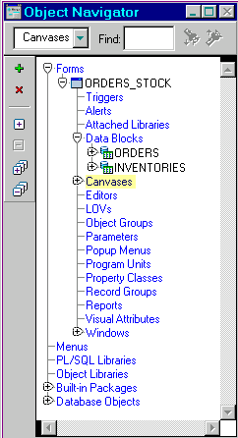
Forms Builder Components:
Object Navigator
  Client-side and server-side objects displayed hierarchically
  Toolbar
  to create, delete or unload, expand or contract
  Icons to represent objects
  Fast Search feature
Notes:
Forms Builder Components: Object Navigator
The interface components of the Forms Builder tool help to provide the flexibility and productivity of the Oracle Forms Developer development environment.
The Object Navigator is a hierarchical browsing and editing interface. You can use the Object Navigator to locate and manipulate application objects quickly and easily. Features include:
A hierarchy represented by indentation and expandable nodes.
(Top-level nodes show module types, database objects, and built-in packages. All other nodes and the objects they contain are indented to indicate that they belong to these higher level nodes.)
Find field and icons, enabling forward and backward searches for any level of node or for an individual item in a node.
Icons in the vertical toolbar replicating common Edit and View menu functions.
An icon next to each object to indicate the object type.
Instructor Note
Mention these briefly. You can start Forms Builder to demonstrate each component as you discuss it.
Demonstration: Open an existing form, and briefly explain the features of the Object Navigator. Leave the form open.

Slide 17
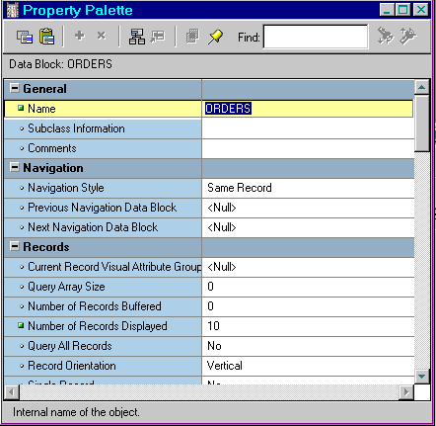
Forms Builder Components:
Property Palette
  Copy and paste properties
  Fast search feature
Notes:
Forms Builder Components: Property Palette
All objects in a module, including the module itself, have properties that you can see and modify in the Property Palette. Features include:
Copy and reuse properties from another object
Find field and icons, similar to Object Navigator
Instructor Note
Demonstration: Open the Property Palette for one of the objects in the form and point out its features. Click on a different object to show that the Property Palette changes to the properties of the new object.

Slide 18
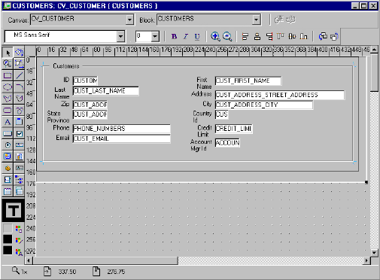
Forms Builder Components:
Layout Editor
Toolbar
Tool
palette
Notes:
Forms Builder Components: Layout Editor
The Layout Editor (or Layout Model) is a graphical design facility for creating and arranging interface items and graphical objects in your application. You can use the Tool palette and the Toolbar available in the Layout Editor to design the style, color, size, and arrangement of visual objects in the application. The layout can include graphical objects and images.
Instructor Note
It is important for the students to gain exposure to the Object Navigator and the Layout Editor in Forms Builder. They will need this knowledge to complete the practice exercise at the end of this lesson.
Demonstration
Go to the Layout Editor. Point out the major tools in the Toolbar. Demonstrate some of the major tools in the Tool Palette.
Draw a rectangle and an ellipse, and also show how to draw a square and a circle by holding down the [Shift] key when using the rectangle and ellipse tools.
Demonstrate selecting multiple objects and show how to group various objects.
Demonstrate resizing, moving, aligning, coloring, and deleting objects.
Demonstrate using the Text tool and changing the font style and size.
Demonstrate how to pin a tool by double-clicking a tool.

Slide 19
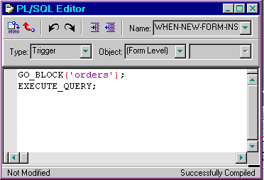
Forms Builder Components:
PL/SQL Editor
With the PL/SQL Editor you can:
  Use PL/SQL in Forms.
  Enter and compile code.
Notes:
Forms Builder Components: PL/SQL Editor
The PL/SQL Editor enables you to incorporate PL/SQL code objects into your form. Code objects in Forms Developer include event triggers, subprograms (functions and procedures), menu item commands, menu startup code, and packages. You enter and compile code in the PL/SQL Editor. You will learn more about the PL/SQL Editor in later lessons when you use it to code triggers in Forms Builder.

Slide 20

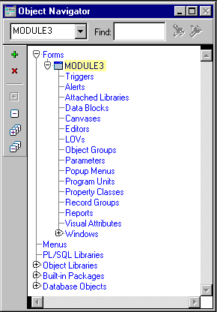
Getting Started in the Forms
Builder Interface
  Start Forms Builder
  Connect to the database:
    Menu:
    Select File > Connect
    OR
    Toolbar:
    Click Connect
Notes:
Getting Started in the Forms Builder Interface
Starting Forms Builder
To start Forms Builder, invoke it from the Oracle 9i Forms group.
When you invoke Forms Builder, you first see a Welcome dialog box. If you click Cancel to dismiss the dialog box, you see the Object Navigator and an empty new module.
If you build applications that access database objects, you need to connect to a database account from the Forms Builder. Connect to a database if you need to:
Compile code that contains SQL
Access database objects in the Object Navigator
Create Oracle Forms Developer objects that are based on database objects

Slide 21
Notes:
Getting Started in the Forms Builder Interface (continued)
How to Connect to Oracle
1. Select File > Connect from the menu, or click the Connect icon in the toolbar.
2. Enter the database user and password in the Connect dialog box. If not connecting to the default database, also provide the necessary connect string or database alias.
Note: Oracle Forms Developer automatically displays the Connect dialog box if you try to perform a task that requires connection.
Instructor Note
Invoke Forms Builder.
Open an existing form. Use one of the forms from the existing prebuilt application.
We use an existing form in this lesson to familiarize students with the Oracle Forms Developer interface. Later we create new forms by using the wizards.
Forms Builder will probably prompt you to connect to the database when it tries to run the form. Also show students the File > Connect menu option.

Slide 22
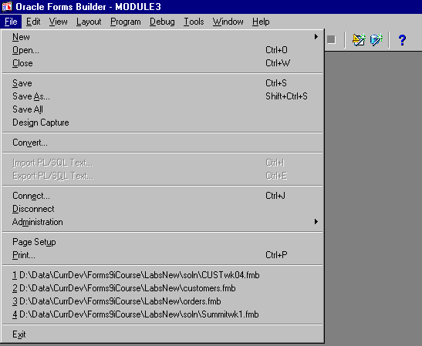
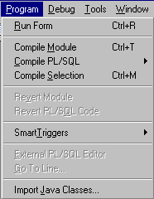

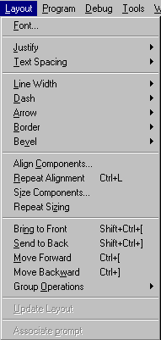
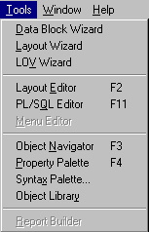
Forms Builder: Menu Structure
Notes:
Navigating the Forms Builder Main Menu
Introduction
The Forms Builder main menu contains options to enable you to create, modify, and manage your form modules.
Common Menu Features
The following table describes some common features in GUI menus:

Slide 23
Notes:
Navigating the Forms Builder Main Menu (continued)
Native GUI Interface
The menu shown in the slide depicts the Windows NT environment. However, menus appear with the same look and feel of your native GUI interface.
For example, in Motif, the Windows Print Dialog options appear as submenus of the Font menu.
Forms Builder Main Menu
Instructor Note
Show the Main menu options, and how they differ in context. For example, show how different Layout menu options are enabled in the Layout Editor when objects are selected, and how these menu options are not enabled in the Object Navigator.
Do not describe Help in detail; there are more details for these options later in this lesson.

Slide 24
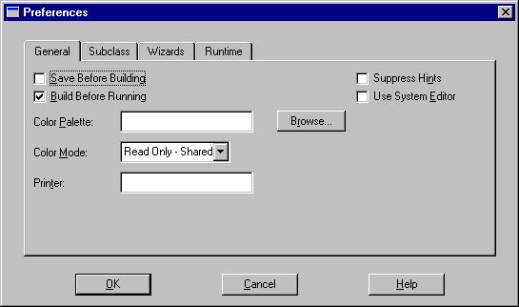
Customizing Your Forms Builder Session
Notes:
Customizing Your Forms Builder Session
What Are Oracle Forms Developer Preferences?
You can use preferences to customize some aspects of your Forms Builder session.
Forms Builder Preferences
There are four tabs in the Preferences dialog box.
To see a description of each preference, click Help in the Preferences dialog or press the Help key ([F1] for Windows NT/95).
In addition to session preferences, you can also set run-time settings that apply to running your form from within the builder.
To modify preferences, perform the following steps:
Select Edit > Preferences.
Specify any options that you require.
Click OK to save changes, or Cancel to cancel changes.

Slide 25
Notes:
Customizing Your Forms Builder Session (continued)
You can specify several related preferences on each of the Preference tabs. The table below describes one preference on each of the tabs:

Slide 26
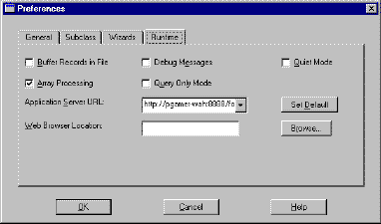
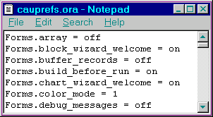
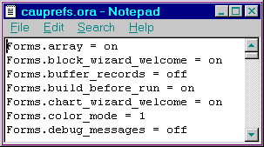
Saving Preferences
Existing
Preferences File
Modified
preferences
Motif:
prefs.ora
Windows:
cauprefs.ora
Updated, merged
Preferences File
Notes:
Saving Preferences
When you click OK in the Preferences dialog box, Oracle Forms Developer updates your current session with the changes.
When you exit the builder (File > Exit), Oracle Forms Developer writes the changes to a preference file for future sessions. The name of the preference file varies on different platforms.
Oracle Forms Developer and Oracle Reports Developer share the same preference file. If the preference file already exists, Oracle Forms Developer merges its changes with the existing file. This does not affect preferences for Reports.
Each option in the preference file is prefixed by the tool name to which it belongs.
Example:
Reports.Object_Access = File
Forms.build_before_run = on
Forms.welcome_dialog = on
Oracle Forms Developer reads the preference file whenever you invoke Forms Builder. Oracle Reports Developer reads the preference file whenever you invoke Report Builder.
Note: The preferences file is an editable text file. If possible, however, you should alter the options in the Preferences dialog box.

Slide 27
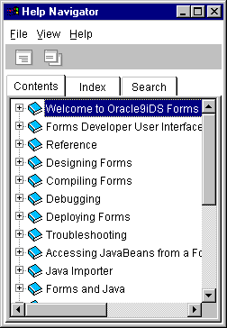
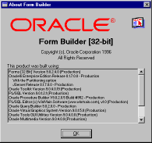
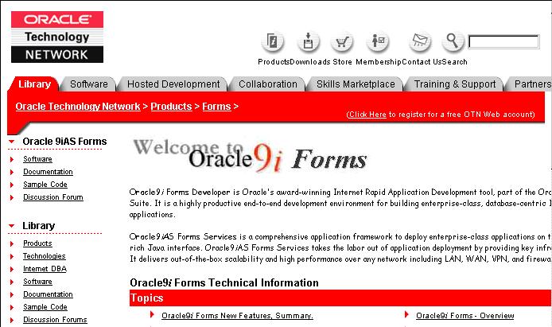
Using the Online Help System
Notes:
Invoking Online Help Facilities
Oracle Forms Developer Help Options
The table below describes the Help menu options in Forms Builder:
You can also invoke context-sensitive online help from Forms Builder by pressing [Help] ([F1] on Windows).

Slide 28
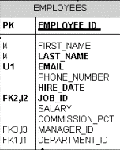

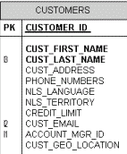
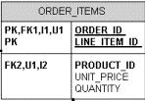
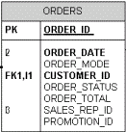
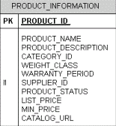
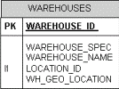

Summit Office Supply Schema
Order Entry
Application
Notes:
Introducing the Course Application
The Summit Office Supply Schema
The simplified table diagram shows the tables that are used throughout the course to build the Forms application. These same tables are used in other Oracle courses as well.
Summit Office Supply is a company that sells office products to customers. Summit has a number of employees in several departments. Some employees are sales representatives who have a relationship with specific customers.
Customers place orders. Each order consists of one or more line items. Each line item represents a product.
Many products have an associated image, in the form of an image file.
The company products are stored in a number of warehouses. The contents of the warehouses are managed in the inventory.

Slide 29
Summit Application
CV_Customer Canvas
Customers
Form
CUSTOMERS
Table
CUSTOMERS Block
CV_Order Canvas
ORDERS
Table
ORDERS Block
Orders
Form
ORDER_ITEMS
Table
ORDER_ITEMS Block
CV_Inventory Canvas
INVENTORIES Block
INVENTORIES
Table
Notes:
The Summit Office Supply Application
The following example of a Forms Builder application will familiarize you with the main run-time facilities of the product. You will also build your own version of this application during the workshops in the course.
The Summit company produces a range of office supplies, which they sell to businesses and individuals (their customers). The Summit application is an order-entry system that maintains customer details, their orders, and the available stock (inventory).
The application consists of two main forms:
Customers form: The Customers facilitates queries on existing customers and the insertion, update, or deletion of customer records. When a customer is selected, the user can open the Orders form to enter or view orders for that customer. The form consists of a single block, the Customers block, a single record block, whose base table is Customers.
Orders form: Opened from the Customers form, the Orders form displays orders for a customer and the line items that belong to each order. Orders may also be created, modified, or deleted in this form. You can also display the stock available on the ordered products. The form consists of three blocks:

Slide 30
Notes:
The Summit Office Supply Application (continued)
Orders block: The Orders block is a single record master block for the form The base table is Orders, but the block also displays associated information from other tables, such as the name of the customer.
Order_Items block: The Order_Items block is the related detail block for an order, showing its line items and the products ordered. This is a multirecord block whose items are on the same canvas as those in the Orders block. The base table of the Order_Items block is Order_Items, but the block displays information from other tables, such as the product description.
Inventories block: The Inventories block is a multirecord block showing warehouse stock for a product. Its items are on a separate canvas, which is assigned to its own window. This block is linked to the current product in the Order_Items block, but the two blocks can operate independently.
Instructor Note
Explain to students that the concepts of blocks, windows, canvases, and so on are presented in later lessons. The descriptions above are just to give an overview of the application. Students may want to refer back to this overview later when the concepts are presented.

Slide 31
Summary
In this lesson, you should have learned that:
  Oracle9i Developer Suite includes components for application development and business intelligence
  Oracle9i Application Server provides services for building and deploying Web applications
  Benefits of Oracle Forms Developer include:
    Rapid Application Development
    Application Partitioning
    Flexible Source Control
    Extended Scalability
    Object Reuse
Notes:
Summary
Oracle9i Developer Suite includes components for application development (JDeveloper, Designer, Software Configuration Manager, and Forms Developer) and for Business Intelligence (Warehouse Builder, Discoverer, and Reports).
Oracle9i Application Server provides a variety of services for building and deploying Web applications, including the Oracle9i HTTP Server (OHS), Oracle9i Containers for J2EE (OC4J), Reports Services, and Forms Services.
Benefits of Oracle Forms Developer include:
Rapid Application Development: Create and modify applications with little or no code
Application Partitioning: Drag-and-drop objects between modules and the database server
Flexible Source Control: Integration with Software Configuration Manager (SCM)
Extended Scalability: Use of server functionality like array DML, database cursors, or bind variables
Object Reuse: Subclassing, object libraries

Slide 32
Summary
  Benefits of Oracle Forms Services include:
    Optimized Web deployment of Forms applications
    Rich Java UI without Java coding
    Generic Java applet to deploy any Forms application
  Oracle Forms Services consists of the Forms client, the Forms Servlet, the Forms Listener Servlet, and the Forms Runtime Engine
  Forms Builder includes the following components:
    Object Navigator
    Property Palette
    Layout Editor
    PL/SQL Editor

Slide 33
Summary
  You can use the Forms Builder menu or associated toolbar icons to navigate around the Forms Builder interface
  The Help menu enables you to use the online help facilities to look up topics, or you can invoke context-sensitive help
  The Edit > Preferences dialog enables you to customize the Forms Builder session
  The course application is a customer and order entry application for Summit Office Supply

Slide 34
Practice 1 Overview
This practice covers the following topics:
  Becoming familiar with the Object Navigator and Layout Editor
  Modifying file access preferences
Notes:
Practice 1 Overview
This practice familiarizes you with Oracle Forms Developer by asking you a number of questions that you answer by navigating around the Forms Builder interface.
Becoming familiar with the Layout Editor and Object Navigator in Forms Builder
Modifying file access preferences
Note
For solutions to this practice, see Practice 1 in Appendix A, “Practice Solutions.”
Instructor Note
This practice is intended to make students familiar and at ease with the interface. For additional help with the Layout Editor, refer them to Appendix F, Using the Layout Editor.

Slide 35
Notes:
Practice 1
1. Invoke Forms Builder. If the Welcome page is displayed, select “Open an existing form”. If the Welcome page is not displayed, select File > Open.
2. Open the Orders.fmb form module from the Open Dialog window.
3. Set your preferences so that Welcome dialogs display when you first open Forms Builder and when you use any of the wizards.
4. Close the Orders form.
5. Open the Summit.fmb form module.
6. Expand the Data Blocks node.
7. Expand the Database Objects node. If you cannot expand the node, connect to the database and try again. What do you see below this node?
8. Collapse the Data Blocks node.
9. Change the layout of the Summit.fmb form module to match the following screenshot. At the end, save your changes, and exit Forms Builder.
a. Invoke the Layout Editor.
b. Move the three summit shapes to the top-right corner of the layout. Align the objects along the bottom edge.
c. Select the summit shape in the middle and place it behind the other two shapes.
d. Draw a box with no fill around the summit shapes.

Slide 36
Notes:
Practice 1 (continued)
e. Add the text Summit Office Supply in the box. If necessary, enlarge the box.
f. Move the Manager_Id and Location_Id items to match the screenshot.
g. Move the First_Name item up to align it at the same level as the Last_Name item.
h. Resize the scroll bar to make it the same height as the three records in the Employees block.
i. Save the form module, and exit Forms Builder.

